Slide 1
Good Morning
1

Slide 2

SAIGON UNIVERSITY
Faculty of information technology
2

Slide 3
Graduation Thesis
SUBJECT MATTER
Class’s ID: DCT118C1
Instructor: Dr. Trịnh Tấn Đạt
Students:
Trần Minh Khoa | ID: 3118411014
Trần Hải Kim Long | ID: 3118411017
Date: 07/12/2022
An Application Of Face Verification Based On Deep Learning Approach
3

Slide 4
01
Introduction
02
Research Content
03
Results and Comparisons
04
Conclusions and recommendations
START
4

Slide 5
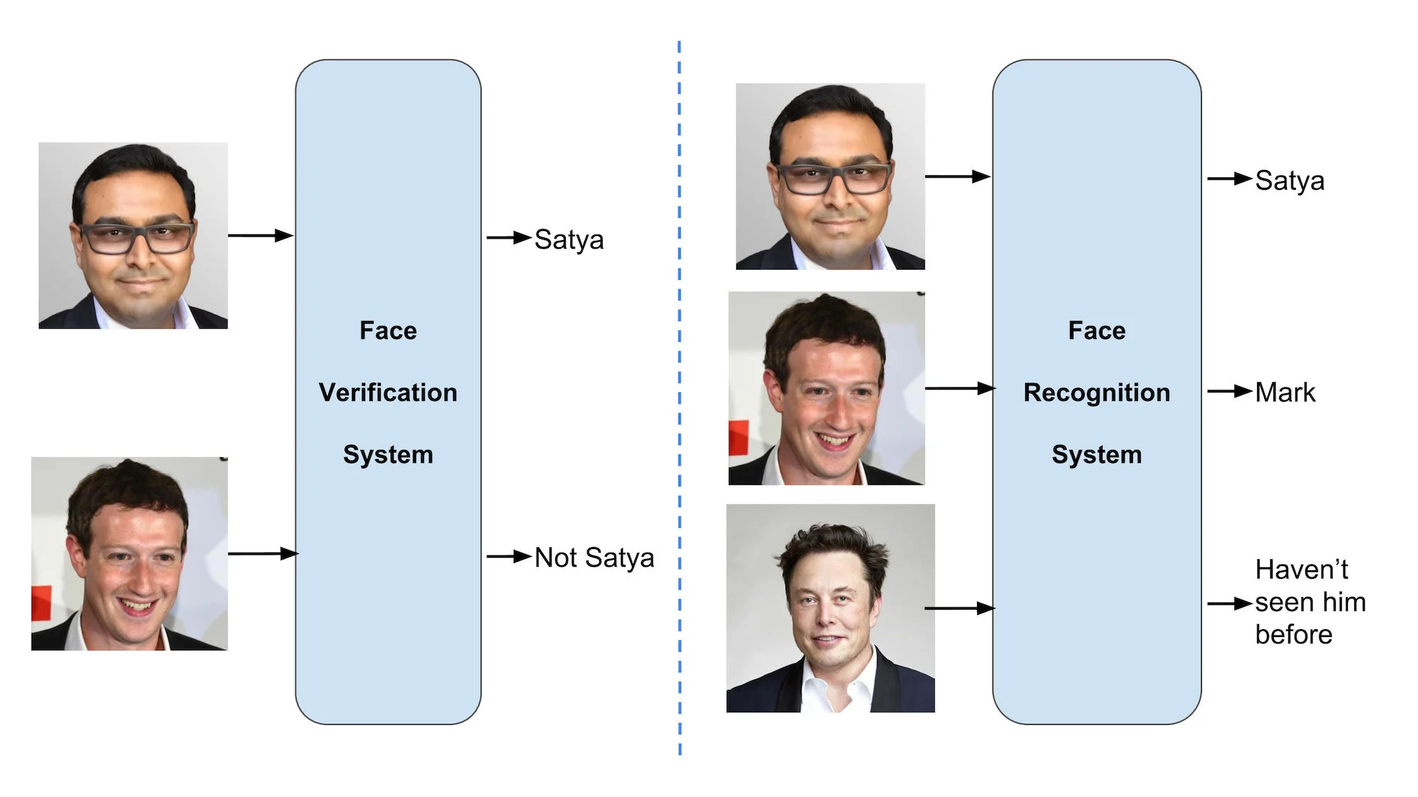
ACTUAL DEMAND
INTRODUCTION
5
Notes:
Face recognition can be classified into two categories: face classification and face verification. Face classification involves classifying a person’s face into the correct face ID, while face verification involves determining whether two face images are of the same person. We can think of face classification as the closed set problem in which the face ID is known in advance from the model, and face verification is the open-set problem where the model may encounter a new face identity.

Slide 6
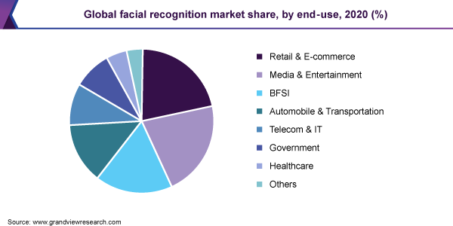
ACTUAL DEMAND
INTRODUCTION
6
Notes:
Facial recognition has become one of the most controversial technologies of recent times. Tech giants like IBM, Microsoft, Amazon, Google and others have done extensive research on this to help improve many mainstream applications, improve security, help organizations stay disconnected in the event of a pandemic, etc.

Slide 7
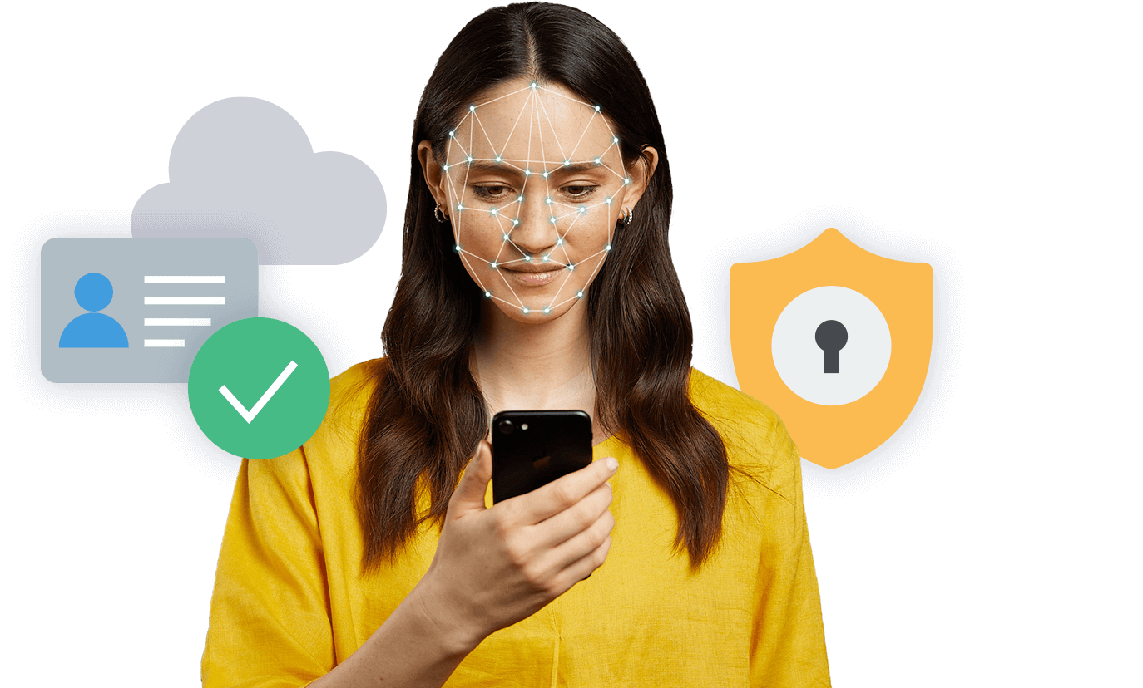

ACTUAL DEMAND
INTRODUCTION
7
Notes:
For the 4.0-day social life, facial recognition contributes a lot to research projects as well as businesses’ activities such as employee face authentication. In the future, facial recognition will become an essential part of businesses. Facial recognition will become common for password authentication features of mobile phones, bank accounts and activities that require the security of applications or businesses. The facial recognition system will certainly develop further. It will also be applied in many different industries.

Slide 8
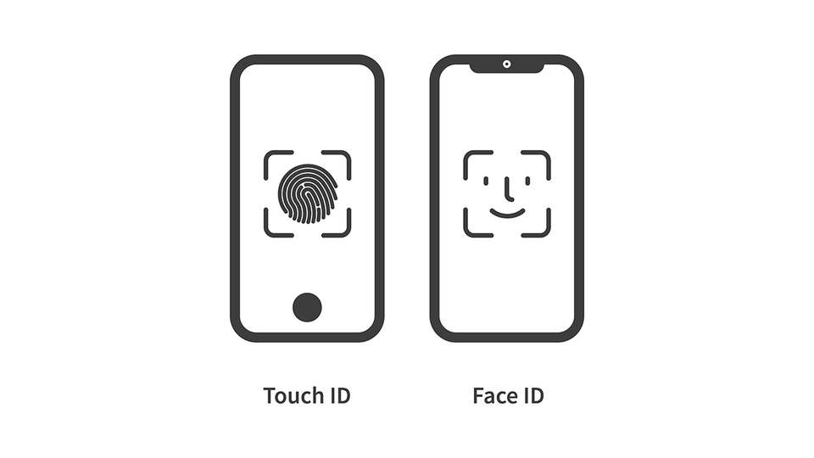
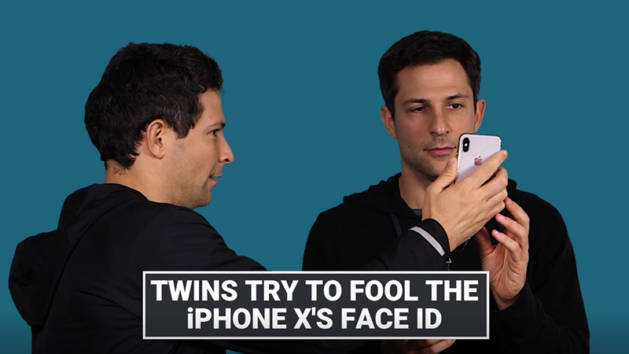
Applications and challenging of the problem
INTRODUCTION
8
Notes:
A facial recognition system is a type of application capable of recognizing an image of a person's face based on the characteristics that the database has previously stored. This system is well developed thanks to the integration of artificial intelligence technology. Helps increase recognition and high accuracy. Unlike fingerprints, faces have many similarities, so identifying features is difficult. For example, some people have similar faces. If the system is down, similarly-formed strangers can still access our content. Currently, twins using facial recognition technology can still access normally, even if the other has never installed the information in the database system.

Slide 9
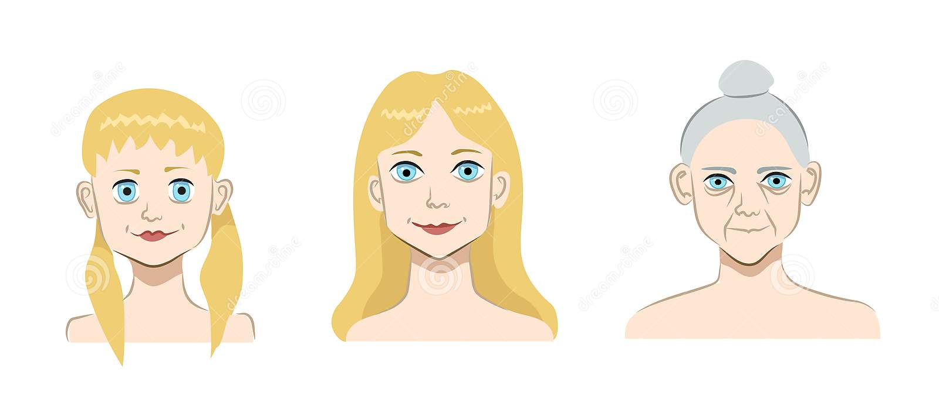
Applications and challenging of the problem
INTRODUCTION
9
Notes:
Difficulties can be mentioned as for a person’s face, in childhood facial features can vary from adult face or in old age so facial verification can predict guess wrong or give incorrect results.

Slide 10
Related works research projects
INTRODUCTION
To address this issue, Learning Face Representation from Scratch (Dong Yi, Zhen Lei, Shengcai Liao, and Stan Z. Li, 2014) of the Center for Biometrics and Security Research & National Laboratory of Pattern Recognition Institute of Automation, Chinese Academy of Sciences (CASIA) proposes a semi-automatical method for collecting face images from the Internet and creating the CASIAWebFace dataset, which contains approximately 10,000 subjects and 500,000 images. They use a database-based 11-layer CNN to learn discriminative representation and achieve state-of-the-art accuracy on (Labelled Faces in the Wild) LFW and (YouTube Faces) YTF.
“In Real-world Attack on MTCNN Face Detection System” (Edgar Kaziakhmedov, Klim Kireev, Grigorii Melnikov, Mikhail Pautov, Aleksandr Petiushko; 2019) paper, they investigate the security of the well-known cascade CNN face detection system - MTCNN and present an easily reproducible and robust attack method. They propose various face attributes that can be printed on a regular white and black printer and attached to either the medical face mask or the face directly.
10

Slide 11

Proposed Approach
INTRODUCTION
We propose MTCNN (Multi-task Cascaded Convolutional Networks) and FaceNet approaches in the research process to go deeper into the process of fully understanding and applying a Face Verification.
11

Slide 12
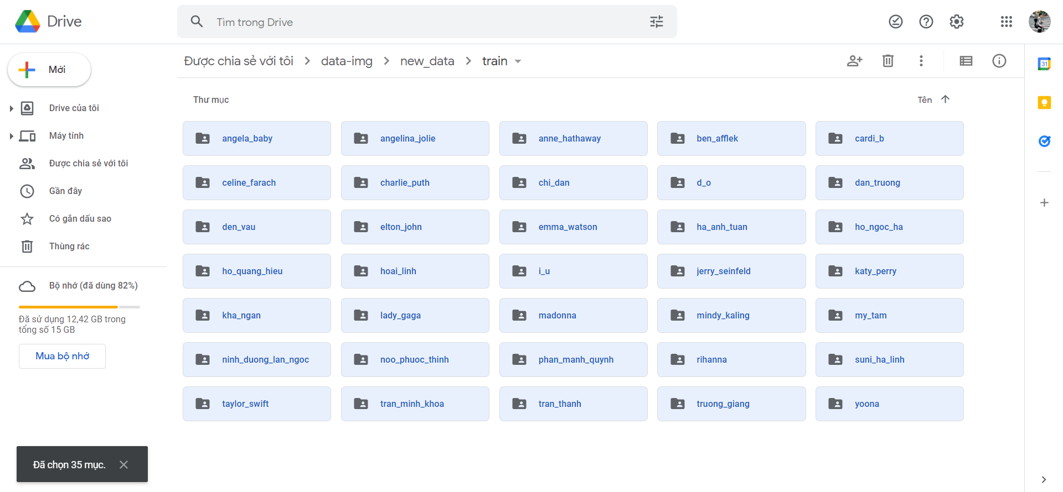
RESEARCH CONTENT
DATASET
12
Notes:
The dataset is used for training and testing; in this case, we collect the well-known celebrity faces in Vietnam, China, Korea, American, and England. The dataset contains 35 celebrity faces in this dataset, so we use this dataset because it is easy to collect.

Slide 13
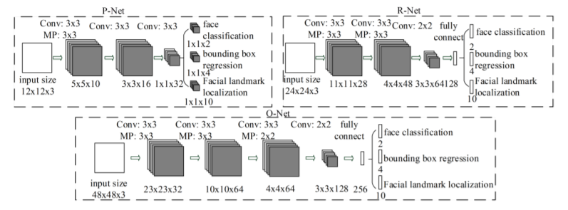
RESEARCH CONTENT
FACE DETECTION USING MTCNN
Figure1: The architecture of P-Net, R-Net, and O-Net
13
Notes:
As mentioned earlier, our approach to solving the verification problem is based on feature matching. Using Multi-Task Cascaded Convolutional Neural Networks (MTCNN) is a neural network which detects faces and facial landmarks on images.
P-Net, R-Net, and O-Net are three neural networks linked in a cascade

Slide 14
RESEARCH CONTENT
14
FACE DETECTION USING MTCNN
Notes:
The output of the network is no longer just the coordinates of the boxes, but returns 3 values including: 4 coordinates of bounding box (out[0]), coordinates of 5 landmark points on the face, including 2 eyes, 1 nose, 2 sides of lips (out[1]) and confidence point of each box (out[2]) ).

Slide 15
RESEARCH CONTENT
ALIGNMENT
Figure 1: Coordinates of both eyes on the image matrix
Figure 2: Illustration of Cosine rule to find the angle
15
Notes:
In our research process, we figured out that in order to increase the accuracy, we have to have one more step before feeding the outputs of the MTCNN into the FACENET.
If left eye is higher than the right eye, we will rotate the picture in the inverse direction of the clock. On the other hand, if the right eye was higher than the left, we would rotate the image clockwise.

Slide 16
RESEARCH CONTENT
FEATURE EXTRACTION USING FACENET
Figure 1: FaceNet’s model structure
Figure 2: Triplet loss
Figure 3: Triplet loss: Image credits
16
Notes:
FaceNet was created by Google researchers who used a Deep Convolutional Neural Network (DCNN) to map photo of a person's face into Euclidean spaces, also known as embedding.
FaceNet generates the embedding vector from a face image as its input (a vector of 128 numbers which represent the most important features of a face).
Pushed away from the anchor
Pulled closer the anchor

Slide 17
RESULTS AND COMPARISONS
SOFTWARE
17
Notes:
This is the workflow of our application which mentioned in the chapter 4 of our thesis report book. You can see the details in that report.

Slide 18
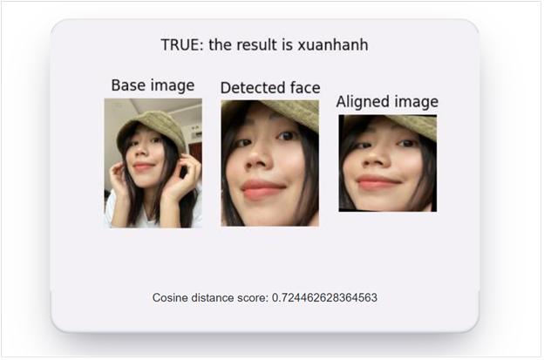
RESULTS AND COMPARISONS
SOFTWARE
18
Notes:
This is our result on the app when we verify a person. So, we will demo it after finishing our presentation

Slide 19
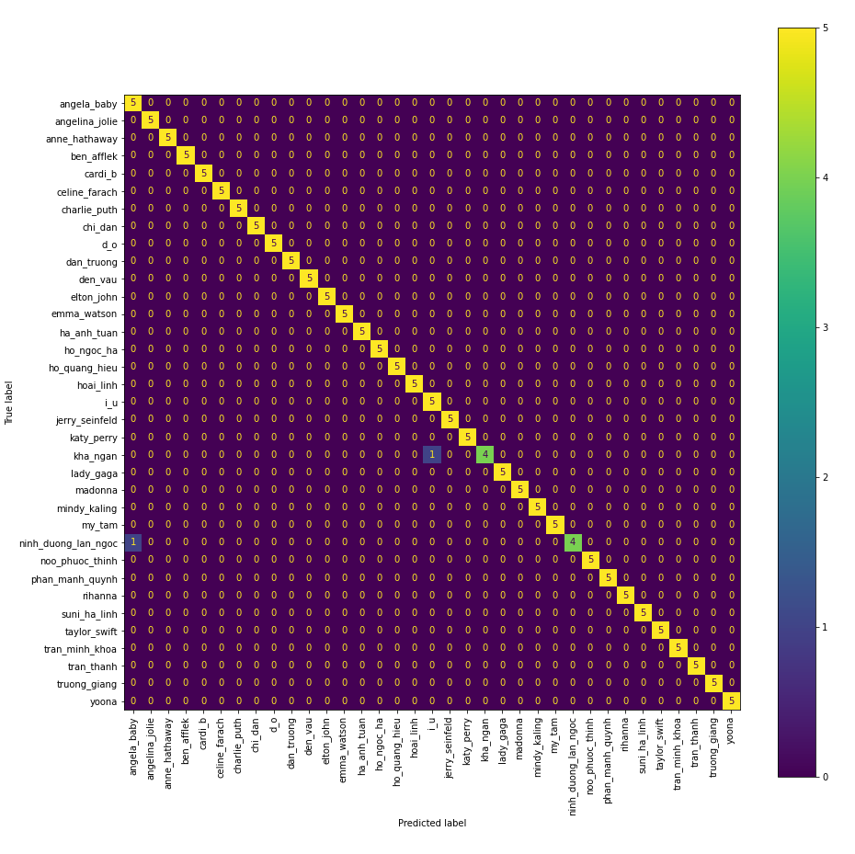
RESULTS AND COMPARISONS
RESULTS WITHOUT ALIGNMENT
Figure 1: Confusion matrix of K-Nearest Neighbor (KNN) without alignment
19

Slide 20
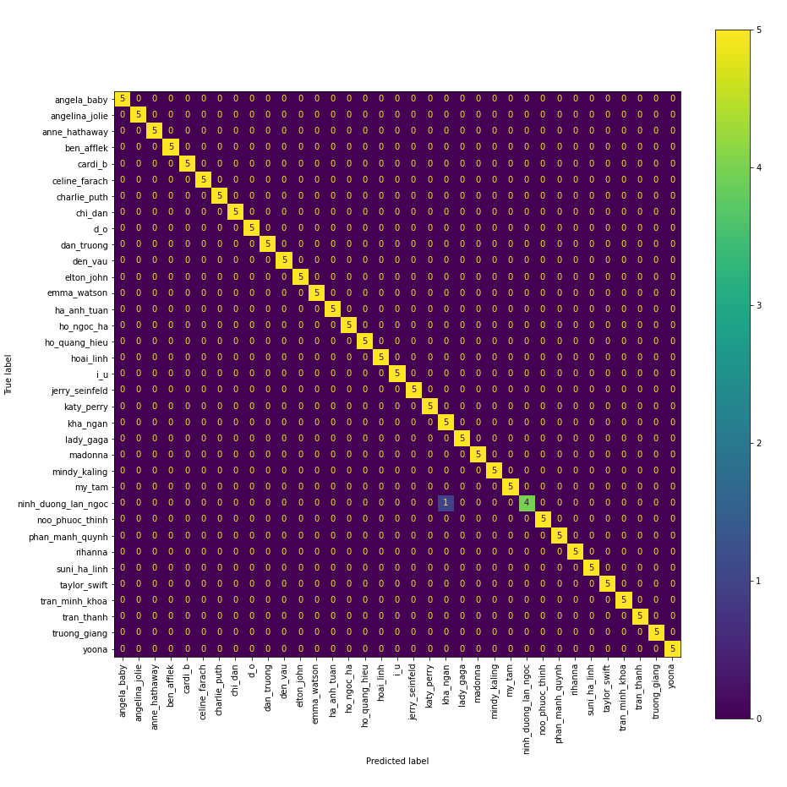
RESULTS AND COMPARISONS
RESULTS WITHOUT ALIGNMENT
Figure 2: Confusion matrix of Naïve Bayes (NB) without alignment
20

Slide 21
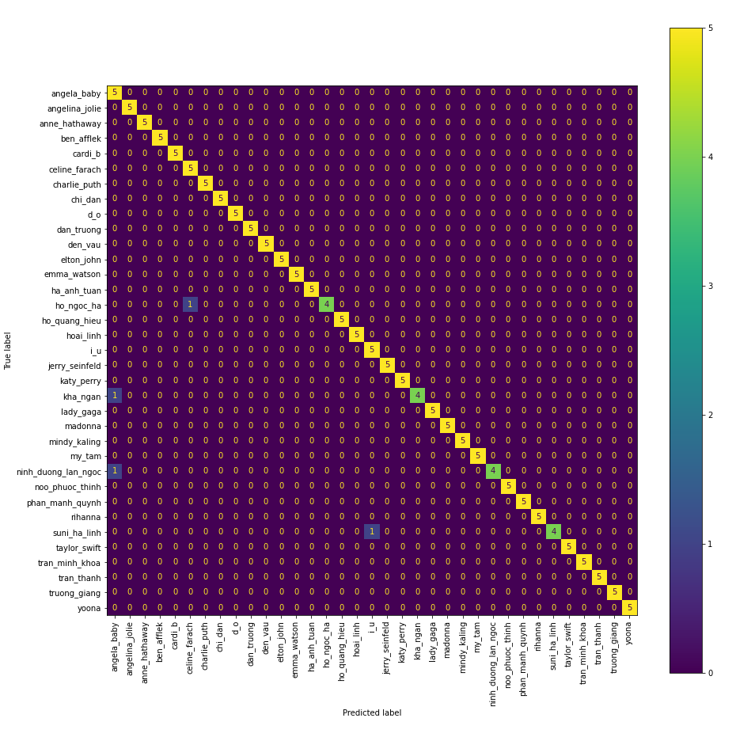
RESULTS AND COMPARISONS
RESULTS WITHOUT ALIGNMENT
Figure 3: Confusion matrix of Random Forest (RF) without alignment
21

Slide 22
RESULTS AND COMPARISONS
RESULTS WITHOUT ALIGNMENT
Figure 4: Confusion matrix of Support Vector Machine (SVM) without alignment
22

Slide 23
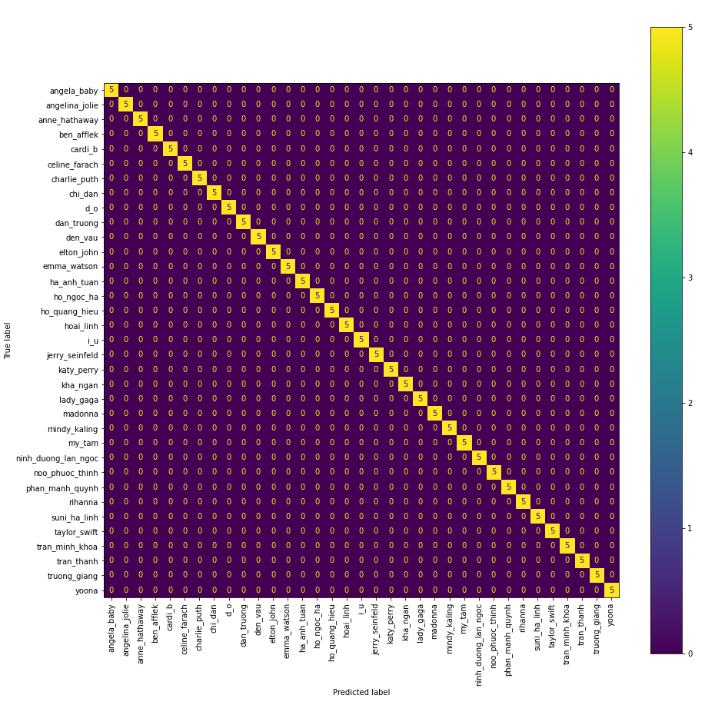
RESULTS AND COMPARISONS
RESULTS WITH ALIGNMENT
Figure 1: Confusion matrix of K-Nearest Neighbor (KNN) with alignment
23

Slide 24

RESULTS AND COMPARISONS
RESULTS WITH ALIGNMENT
Figure 2: Confusion matrix of Naïve Bayes (NB) with alignment
24

Slide 25
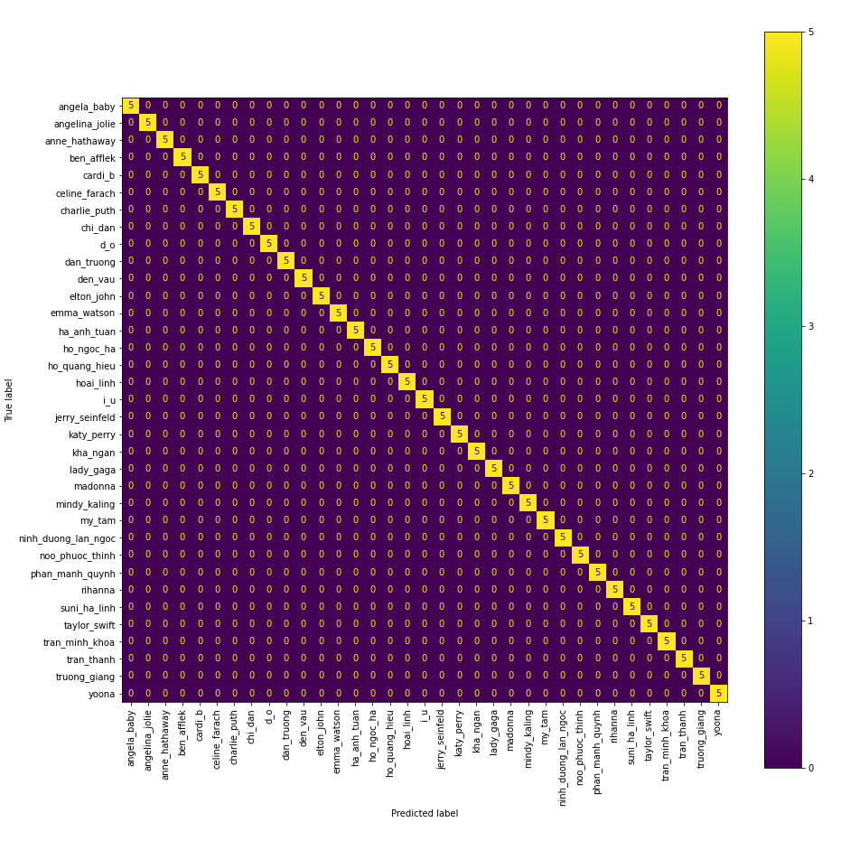
RESULTS AND COMPARISONS
RESULTS WITH ALIGNMENT
Figure 3: Confusion matrix of Random Forest (RF) with alignment
25

Slide 26
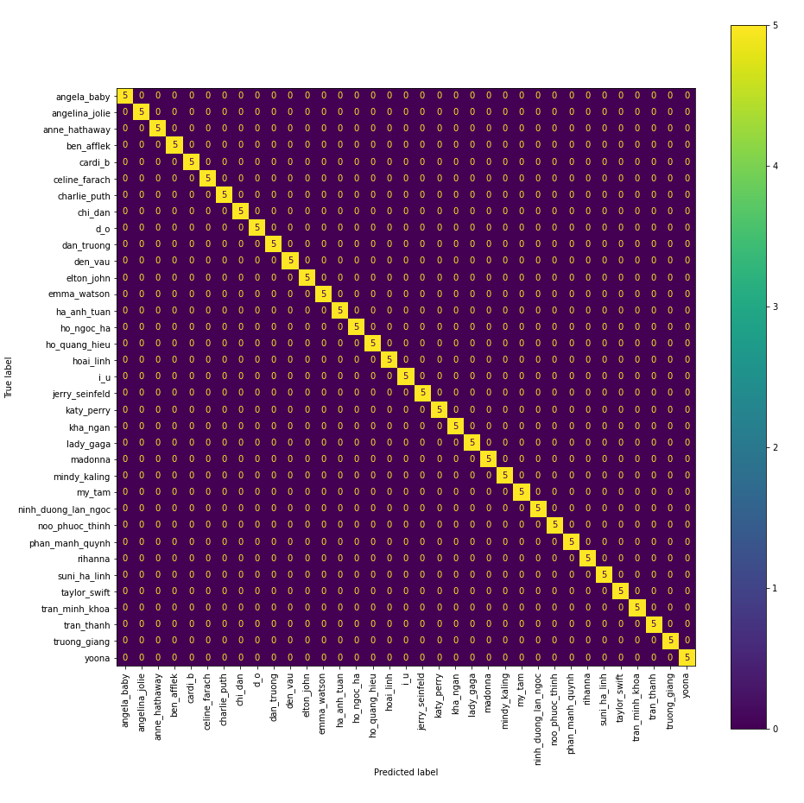
RESULTS AND COMPARISONS
RESULTS WITH ALIGNMENT
Figure 4: Confusion matrix of Support Vector Machine (SVM) with alignment
26

Slide 27
RESULTS AND COMPARISONS
 | KNN | NB | RF | SVM
Training Accuracy (%) | 98.998 | 99.833 | 100 | 100
Testing Accuracy (%) | 98.857 | 99.429 | 97.714 | 98.857
TRAINING AND TESING ACCURACY
Table 1: Results without alignment
 | KNN | NB | RF | SVM
Training Accuracy (%) | 99.833 | 99.833 | 100 | 100
Testing Accuracy (%) | 100 | 100 | 100 | 100
Table 2: Results with alignment
27
Notes:
These are statistics /stəˈtɪstɪks/ about the accuracy of each model with alignment and without alignment.
With the data from table 2, we can see that the accuracy has increased significantly
In the last part, I will leave it to my teammate "Long" to present

Slide 28
Conclusions and recommendations
28
Notes:
This is the result of our experiment, as well as the development of our first real-world application, which we combined the MTCNN with the trained FaceNet model. Our results are not particularly impressive in comparison to the achievements in face recognition in general and face vetification in particular, but in general, we have gained knowledge and research experience in this field. And, without a doubt, in the future, we will have the opportunity to improve, increase efficiency, and create a comprehensive application in order to contribute some achievements in the field of global technology in general, and the Vietnamese technology sector in particular.

Slide 29
THANK YOU
29

